Slide 1


COMMENT DETECTION PROJECT
Submitted by : Bhushan Kumar Sharma
Designation: Intern Data Scientist
Company : Flip Robo Technologies

Slide 2
PROBLEM STATEMENT
The proliferation of social media enables people to express their opinions widely online. However, at the same time, this has resulted in the emergence of conflict and hate, making online environments uninviting for users. Although researchers have found that hate is a problem across multiple platforms, there is a lack of models for online hate detection.
Online hate, described as abusive language, aggression, cyberbullying, hatefulness and many others has been identified as a major threat on online social media platforms. Social media platforms are the most prominent grounds for such toxic behaviour.
There has been a remarkable increase in the cases of cyberbullying and trolls on various social media platforms. Many celebrities and influences are facing backlashes from people and have to come across hateful and offensive comments. This can take a toll on anyone and affect them mentally leading to depression, mental illness, self-hatred and suicidal thoughts.
Internet comments are bastions of hatred and vitriol. While online anonymity has provided a new outlet for aggression and hate speech, machine learning can be used to fight it. The problem we sought to solve was the tagging of internet comments that are aggressive towards other users. This means that insults to third parties such as celebrities will be tagged as unoffensive, but “u are an idiot” is clearly offensive.
Our goal is to build a prototype of online hate and abuse comment classifier which can used to classify hate and offensive comments so that it can be controlled and restricted from spreading hatred and cyberbullying.

Slide 3
DATASET AND DESCRIPTION
The data set contains the training set, which has approximately 1,59,000 samples and the test set which contains nearly 1,53,000 samples. All the data samples contain 8 fields which includes ‘Id’, ‘Comments’, ‘Malignant’, ‘Highly malignant’, ‘Rude’, ‘Threat’, ‘Abuse’ and ‘Loathe’.
The label can be either 0 or 1, where 0 denotes a NO while 1 denotes a YES. There are various comments which have multiple labels. The first attribute is a unique ID associated with each comment.
Malignant: It is the label column, which includes values 0 and 1, denoting if the comment is malignant or not.
Highly Malignant: It denotes comments that are highly malignant and hurtful.
Rude: It denotes comments that are very rude and offensive
Threat: It contains indication of the comments that are giving any threat to someone.
Abuse: It is for comments that are abusive in nature.
Loathe: It describes the comments which are hateful and loathing in nature.
ID: It includes unique Ids associated with each comment text given.
Comment Text: This column contains the comments extracted from various social media platforms

Slide 4
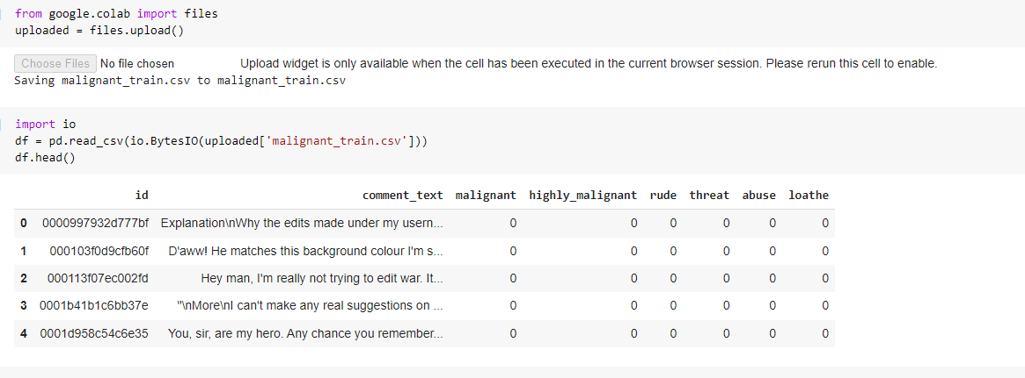
LOADING DATASET
Two dataset has loaded one is for training and second is for to prediction comment type

Slide 5
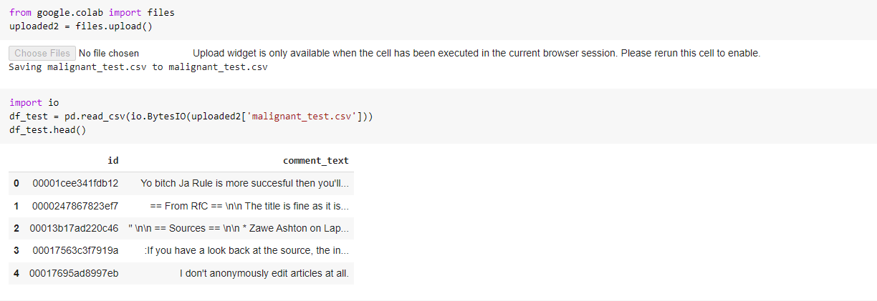
LOADING DATASET
We have to apply all operation on test data too as applied on train dataset

Slide 6
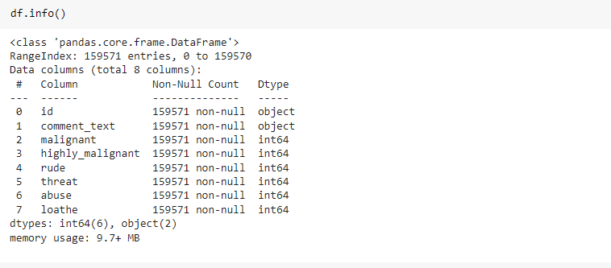
INFORMATION OF DATASET
No null value present and training dateset is having 159571 records for machine learning.

Slide 7
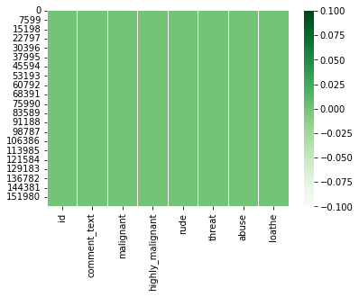
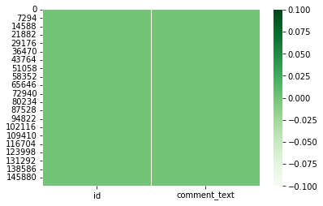
CHECKING NULL VALUES
Training Dataset
Testing Dataset
As shown in above diagram, both images are cleaned which indicating no null values are present in the dataset

Slide 8


Data Preprocessing
Created new columns for length to get amount of cleaned data records
Converted all text into lower case:
Replace email address with email:

Slide 9

Data Preprocessing
Replace URL with Web address:
Replace money symbols with “moneysymb” £:
Replace 10 digit phone numbers:

Slide 10



Data Preprocessing
Replace numbers with “number”:
Remove punctuation:
Replace whitespace between terms with a single space:

Slide 11

Data Preprocessing
Remove leading and trailing whitespace

Slide 12
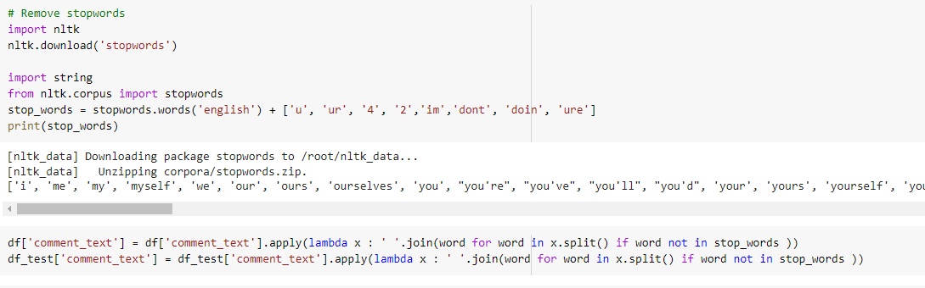

Data Preprocessing
Applied operation to remove stop words
By finding this Len of clean Review and Text we can see the content weightage, how much data we have cleaned

Slide 13
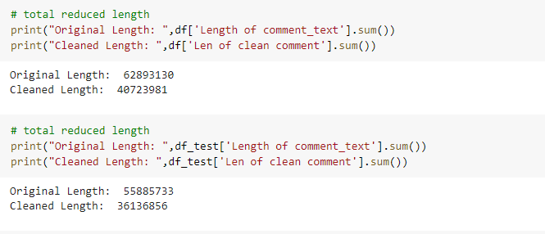
Data Preprocessing
Applied operation to remove stop words
As we see the difference in number , which indicating how much data we have cleaned

Slide 14
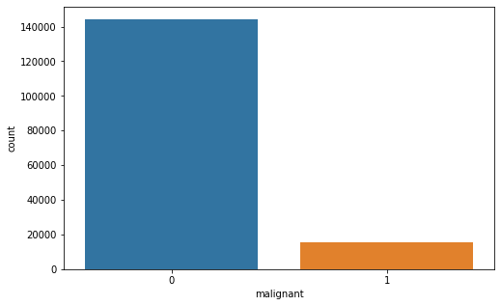
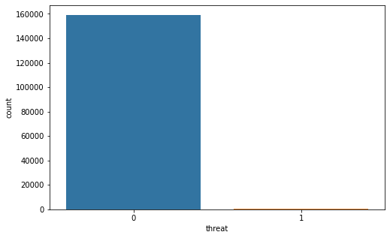
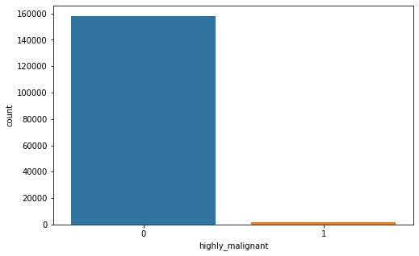
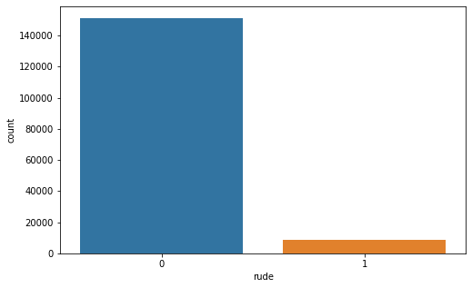
COUNT PLOT FOR LABELS
Review text distribution before cleaning:

Slide 15
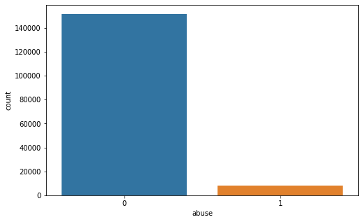
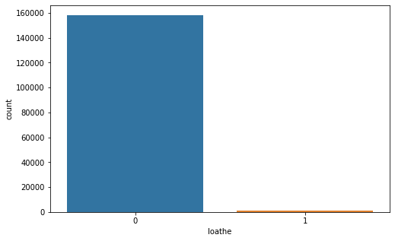
COUNT PLOT FOR LABELS
Review text distribution before cleaning:

Slide 16
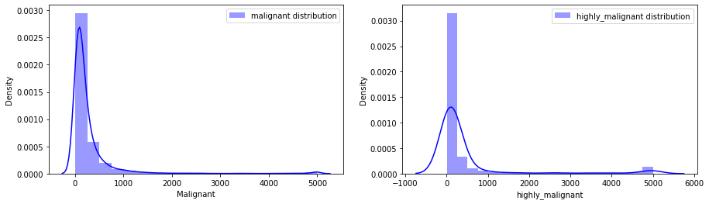
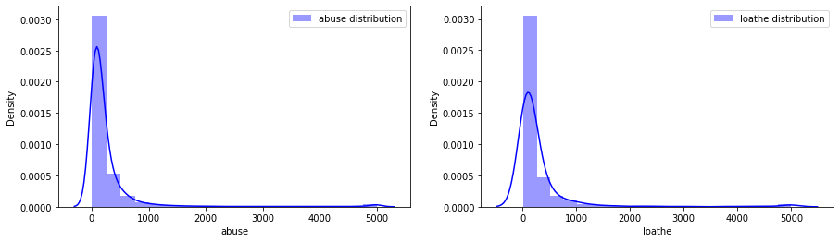
Visualization
Review text distribution before cleaning:

Slide 17
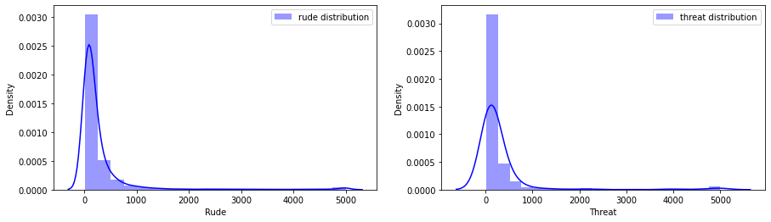
Visualization
Review text distribution before cleaning:

Slide 18
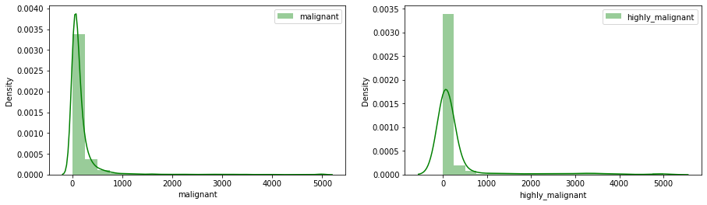
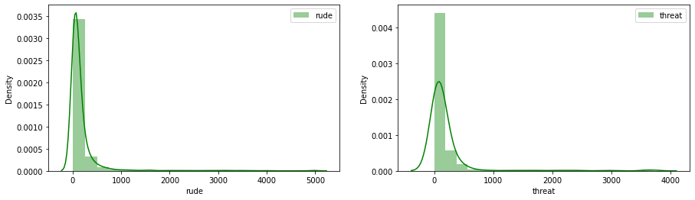
Visualization
Review text distribution After cleaning:

Slide 19
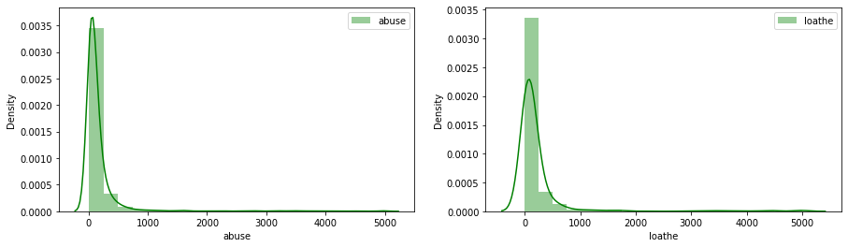
Visualization
Review text distribution After cleaning:

Slide 20
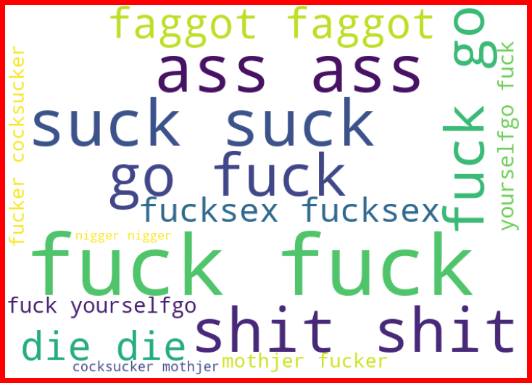
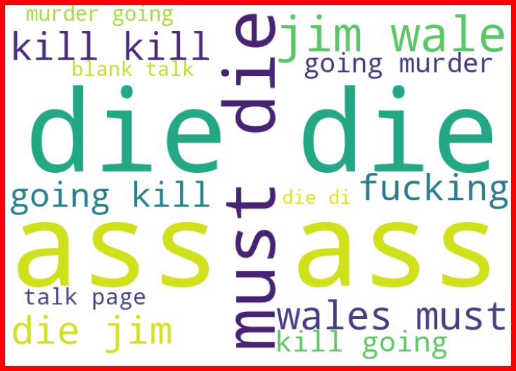
Visualization
Word Cloud:
Highly Malignant
Abuse

Slide 21
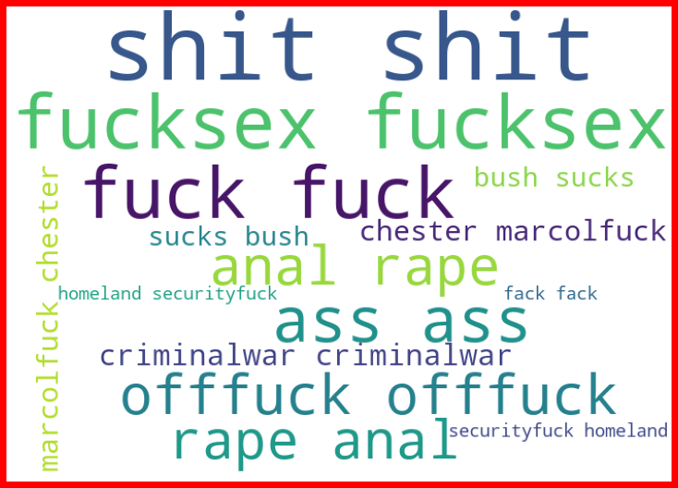
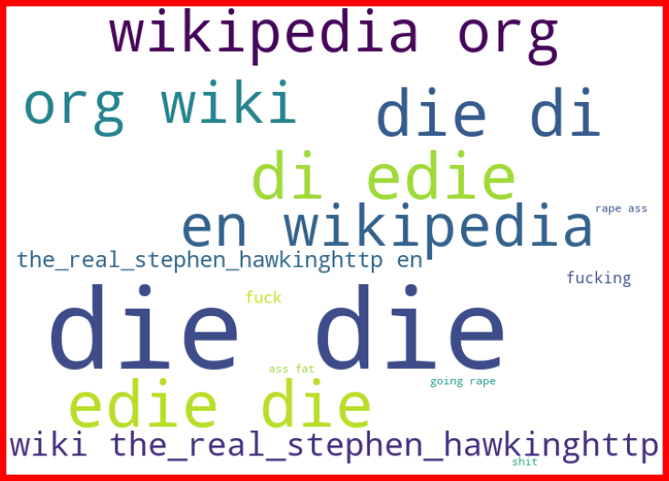
Visualization
Word Cloud:
Threat
Loathe

Slide 22
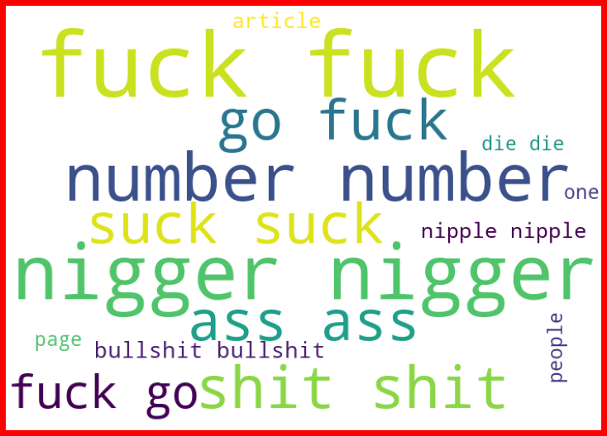
Visualization
Word Cloud:
Rude

Slide 23
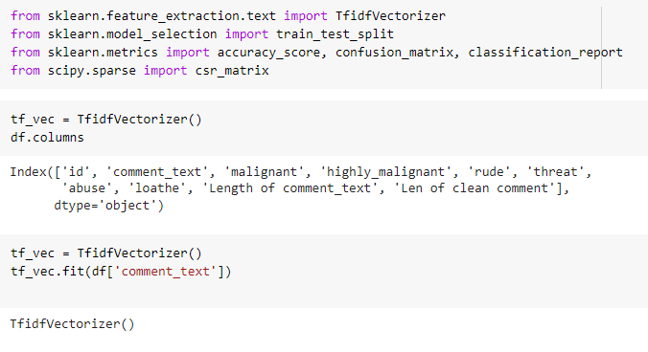
Tf Vectorization
Apply TfidVectorizer to the “Comment” columns:

Slide 24
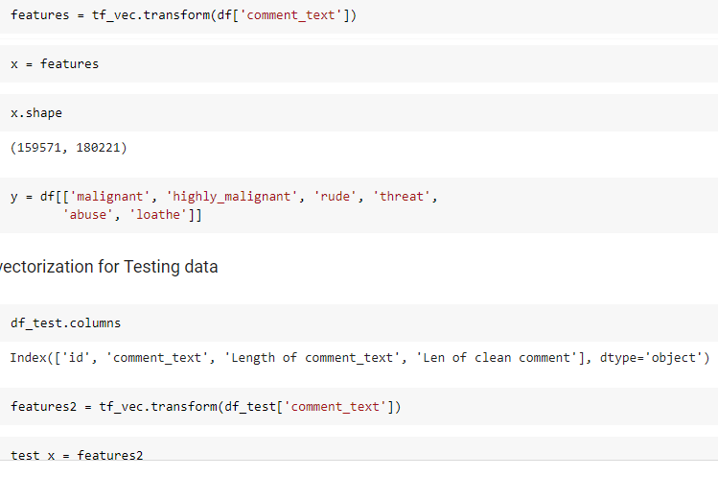
Tf Vectorization
Apply TfidVectorizer to the “Comment” columns for testing dataset:

Slide 25
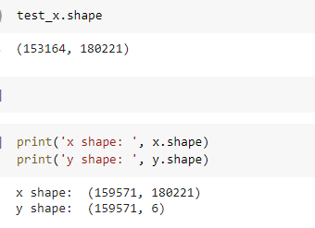
Tf Vectorization
Apply TfidVectorizer to the “Comment” columns:

Slide 26
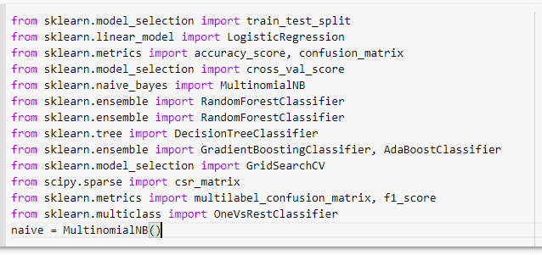
Machine learning
These libraries used for building model of machine learning

Slide 27
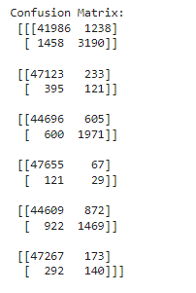
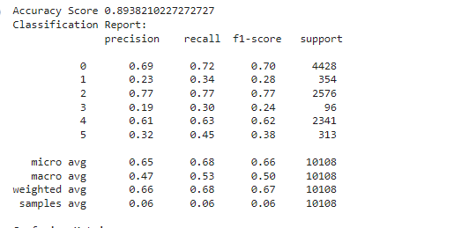
MultinomialNB model
Giving good accuracy but we have many more accuracy to apply

Slide 28
Decision Tree Classifier model
This model is also giving almost similar accuracy as MultinomialNB is giving

Slide 29
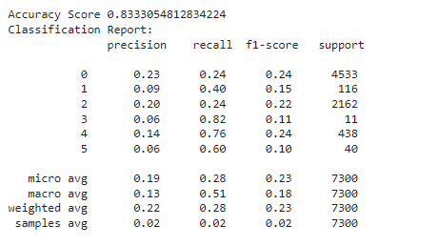
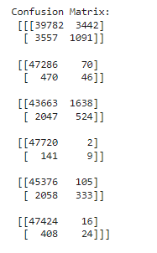
Kneighbor Classifier Model
This algorithm is having less accuracy as compare to previously applied algorithm

Slide 30
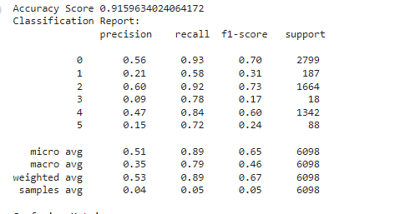
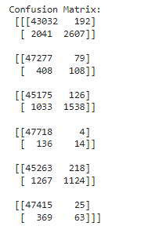
Logistic Regression Model
Giving highest accuracy as compare to previously applied algorithms

Slide 31
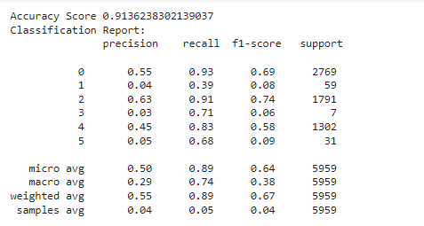
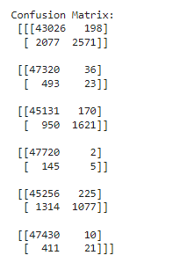
Applied Bagging and Boosting techniques
RandomForestClassifer:
Giving good accuracy but it is overfitted model as checked at the time of model building

Slide 32
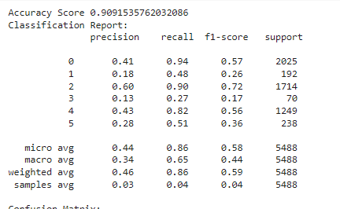
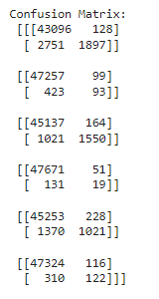
GradientBoosting:
Having less accuracy as compare to Ramdomforest and Logistic regression

Slide 33
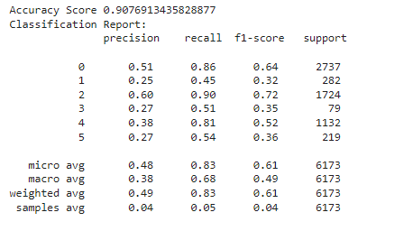
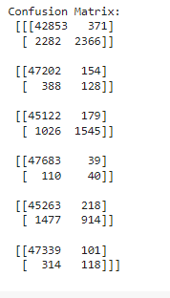
AdaBoosting:
This model is giving less accuracy as compare to previously used algorithms

Slide 34
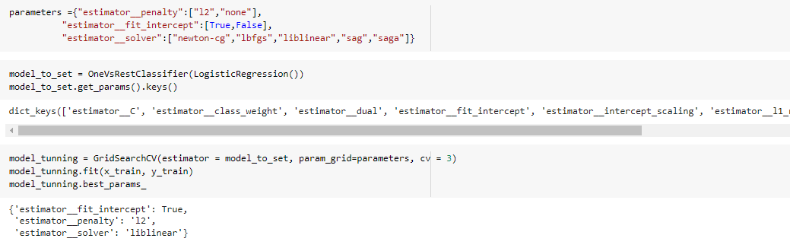
Hyper Parameter Tuning for logistic Model:
Getting best parameter for Logistic Regression alogrithm

Slide 35
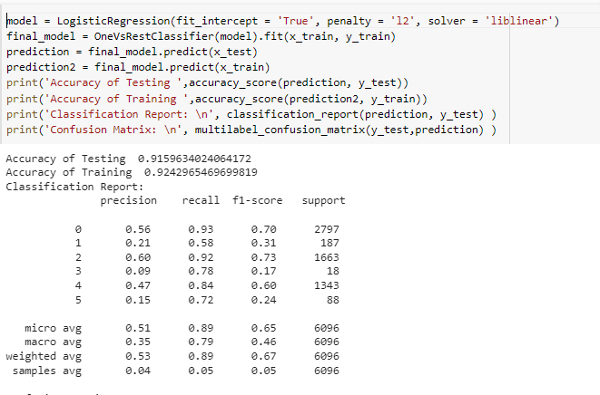
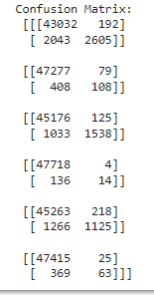
Final Model Performance:
Best parameters are applied here and got final model with Logistic Regression algorithm

Slide 36
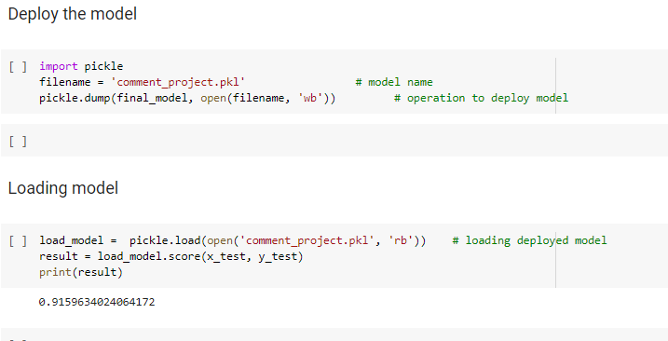

DEPLOY and load model:
After deploying again load that same model and got same accuracy as previous achieved

Slide 37
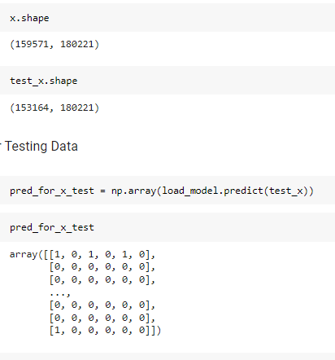
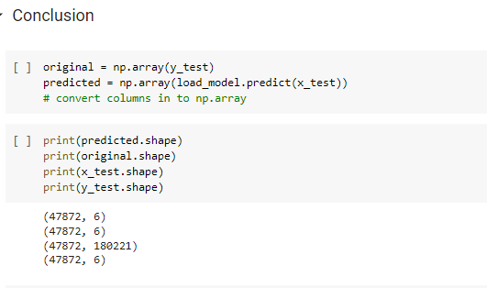
Conclusion:
Here prediction is mentioned for x_test data of training dataset

Slide 38
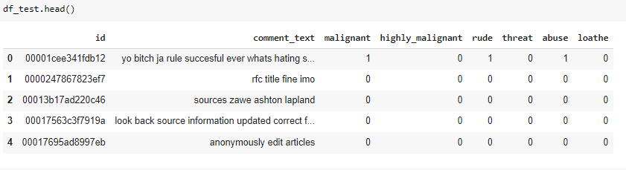
Prediction for Testing Dataset:
Final prediction for testing dataset

Slide 39
Thanks you

